Slide 1

Machine learning course
Presented by Abdel Rahman AlSabbagh
Lecture #3 – Sat - 17.5.2023

Slide 2


Tech Requirements
In the name of Allah, the most gracious, the most merciful, we start :)
Machine Learning Course
Abdel Rahman AlSabbagh

Slide 3
Tech Requirements
Today’s Quote
“Growth happens without requiring much effort”
- Chris Gardener.
Machine Learning Course
Abdel Rahman AlSabbagh
Notes:
When most people hear “Machine Learning,” they picture a robot: a dependable butler
or a deadly Terminator depending on who you ask. But Machine Learning is not
just a futuristic fantasy, it’s already here. In fact, it has been around for decades in
some specialized applications, such as Optical Character Recognition (OCR). But the
first ML application that really became mainstream, improving the lives of hundreds
of millions of people, took over the world back in the 1990s: it was the spam filter.
Not exactly a self-aware Skynet, but it does technically qualify as Machine Learning
(it has actually learned so well that you seldom need to flag an email as spam anymore).
It was followed by hundreds of ML applications that now quietly power hundreds
of products and features that you use regularly, from better recommendations
to voice search.
Where does Machine Learning start and where does it end? What exactly does it
mean for a machine to learn something? If I download a copy of Wikipedia, has my
computer really “learned” something? Is it suddenly smarter? In this chapter we will
start by clarifying what Machine Learning is and why you may want to use it.
Then, before we set out to explore the Machine Learning continent, we will take a
look at the map and learn about the main regions and the most notable landmarks:
supervised versus unsupervised learning, online versus batch learning, instance-based
versus model-based learning. Then we will look at the workflow of a typical ML
project, discuss the main challenges you may face, and cover how to evaluate and
fine-tune a Machine Learning system.

Slide 4
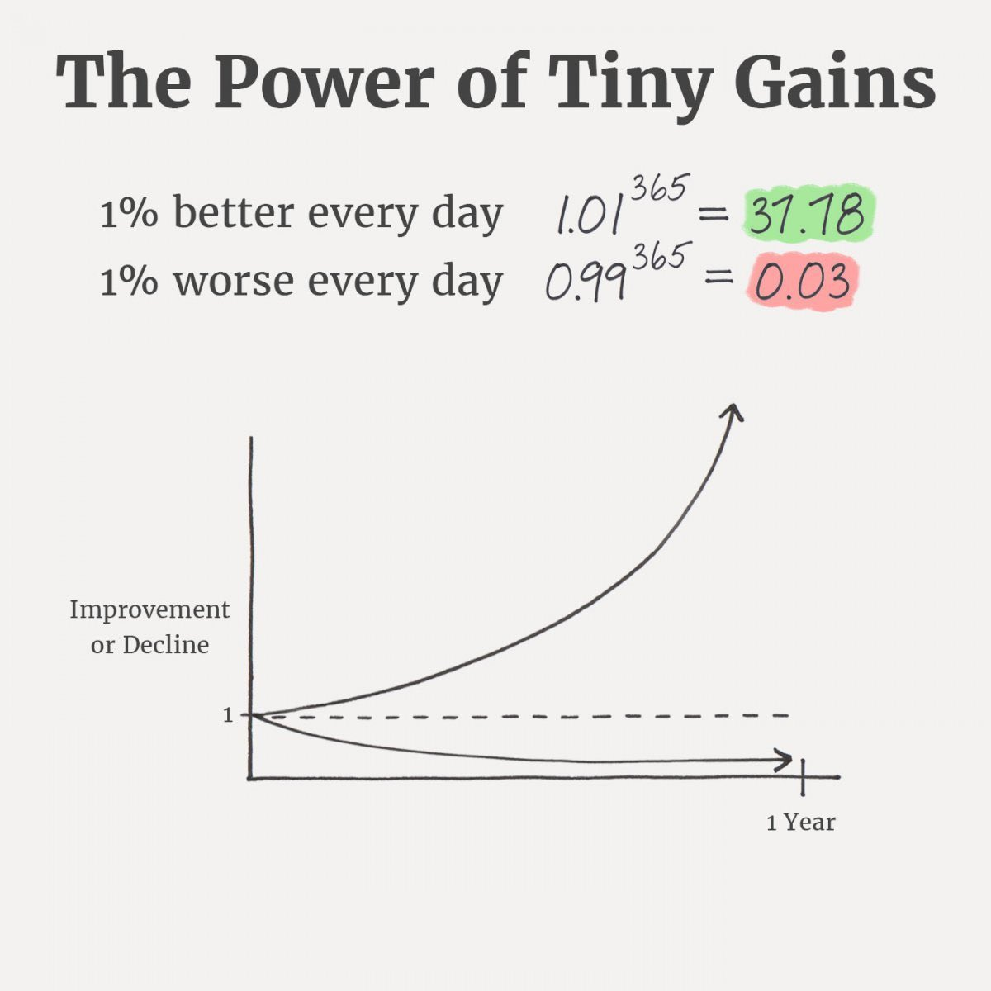
Tech Requirements
Today’s Quote
Machine Learning Course
Abdel Rahman AlSabbagh
Notes:
When most people hear “Machine Learning,” they picture a robot: a dependable butler
or a deadly Terminator depending on who you ask. But Machine Learning is not
just a futuristic fantasy, it’s already here. In fact, it has been around for decades in
some specialized applications, such as Optical Character Recognition (OCR). But the
first ML application that really became mainstream, improving the lives of hundreds
of millions of people, took over the world back in the 1990s: it was the spam filter.
Not exactly a self-aware Skynet, but it does technically qualify as Machine Learning
(it has actually learned so well that you seldom need to flag an email as spam anymore).
It was followed by hundreds of ML applications that now quietly power hundreds
of products and features that you use regularly, from better recommendations
to voice search.
Where does Machine Learning start and where does it end? What exactly does it
mean for a machine to learn something? If I download a copy of Wikipedia, has my
computer really “learned” something? Is it suddenly smarter? In this chapter we will
start by clarifying what Machine Learning is and why you may want to use it.
Then, before we set out to explore the Machine Learning continent, we will take a
look at the map and learn about the main regions and the most notable landmarks:
supervised versus unsupervised learning, online versus batch learning, instance-based
versus model-based learning. Then we will look at the workflow of a typical ML
project, discuss the main challenges you may face, and cover how to evaluate and
fine-tune a Machine Learning system.

Slide 5
Tech Requirements
Course Outline
Machine Learning Overview
The Machine Learning Process
Introduction to Classification
Machine Learning Model Training
Support Vector Machines
Decision Trees
Ensemble Learning and Random Forests
Unsupervised Learning Techniques
Artificial Neural Networks
Resources used:
Hands-on Machine Learning with Scikit-Learn, Keras, and TensorFlow by Aurélien Géron
Machine Learning Specialization by Andrew Ng and Stanford Online
Machine Learning Course
Abdel Rahman AlSabbagh

Slide 6
Tech Requirements
Types of Machine Learning Systems
Types of Machine Learning Systems
Supervised/Unsupervised Learning
Batch and Online Learning
Instance-Based Versus Model-Based Learning
Supervised learning
Unsupervised learning
Semisupervised learning
Reinforcement Learning
Machine Learning Course
Abdel Rahman AlSabbagh

Slide 7
Tech Requirements
Recap
Main Challenges of Machine Learning
Bad Data
Bad Algorithm
Insufficient Quantity of Training Data
Nonrepresentative Training Data
Poor-Quality Data
Irrelevant Features
Overfitting the Training Data
Underfitting the Training Data
Machine Learning Course
Abdel Rahman AlSabbagh
Notes:
One solution is to hold out part of the training pictures (from the web) in yet another set that
Andrew Ng calls the train-dev set. After the model is trained (on the training set, not
on the train-dev set), you can evaluate it on the train-dev set: if it performs well, then
the model is not overfitting the training set, so if performs poorly on the validation
set, the problem must come from the data mismatch. You can try to tackle this problem
by preprocessing the web images to make them look more like the pictures that
will be taken by the mobile app, and then retraining the model. Conversely, if the
model performs poorly on the train-dev set, then the model must have overfit the
training set, so you should try to simplify or regularize the model, get more training
data and clean up the training data, as discussed earlier.
No Free

Slide 8
Tech Requirements
Recap
Testing and Validating
Hyperparameter Tuning and Model Selection
Data Mismatch
Machine Learning Course
Abdel Rahman AlSabbagh
Notes:
One solution is to hold out part of the training pictures (from the web) in yet another set that
Andrew Ng calls the train-dev set. After the model is trained (on the training set, not
on the train-dev set), you can evaluate it on the train-dev set: if it performs well, then
the model is not overfitting the training set, so if performs poorly on the validation
set, the problem must come from the data mismatch. You can try to tackle this problem
by preprocessing the web images to make them look more like the pictures that
will be taken by the mobile app, and then retraining the model. Conversely, if the
model performs poorly on the train-dev set, then the model must have overfit the
training set, so you should try to simplify or regularize the model, get more training
data and clean up the training data, as discussed earlier.
No Free

Slide 9
Tech Requirements
The Machine Learning Process
Linear regression.
Loss and cost functions.
Visualizing the cost function.
Gradient descent.
Learning rate.
Gradient descent for linear regression.
Evaluation metrics.
Linear regression for multiple features.
Gradient descent for multiple features.
Feature scaling.
Source: Machine Learning Specialization by Andrew Ng and Stanford Online.
Machine Learning Course
Abdel Rahman AlSabbagh
Notes:
One solution is to hold out part of the training pictures (from the web) in yet another set that
Andrew Ng calls the train-dev set. After the model is trained (on the training set, not
on the train-dev set), you can evaluate it on the train-dev set: if it performs well, then
the model is not overfitting the training set, so if performs poorly on the validation
set, the problem must come from the data mismatch. You can try to tackle this problem
by preprocessing the web images to make them look more like the pictures that
will be taken by the mobile app, and then retraining the model. Conversely, if the
model performs poorly on the train-dev set, then the model must have overfit the
training set, so you should try to simplify or regularize the model, get more training
data and clean up the training data, as discussed earlier.
No Free

Slide 10
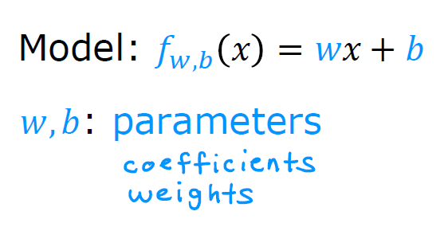
Tech Requirements
Linear Regression
Machine Learning Course
Abdel Rahman AlSabbagh
Notes:
One solution is to hold out part of the training pictures (from the web) in yet another set that
Andrew Ng calls the train-dev set. After the model is trained (on the training set, not
on the train-dev set), you can evaluate it on the train-dev set: if it performs well, then
the model is not overfitting the training set, so if performs poorly on the validation
set, the problem must come from the data mismatch. You can try to tackle this problem
by preprocessing the web images to make them look more like the pictures that
will be taken by the mobile app, and then retraining the model. Conversely, if the
model performs poorly on the train-dev set, then the model must have overfit the
training set, so you should try to simplify or regularize the model, get more training
data and clean up the training data, as discussed earlier.
No Free

Slide 11
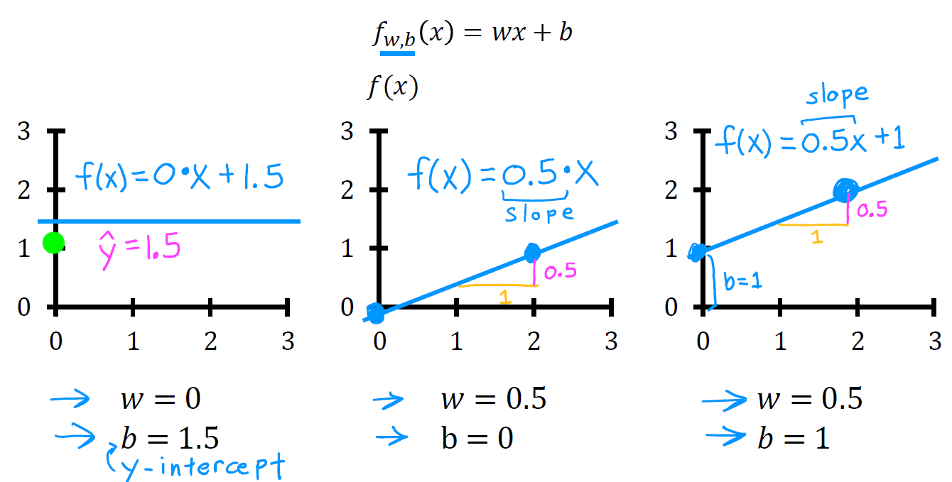
Tech Requirements
Linear Regression
Machine Learning Course
Abdel Rahman AlSabbagh
Notes:
One solution is to hold out part of the training pictures (from the web) in yet another set that
Andrew Ng calls the train-dev set. After the model is trained (on the training set, not
on the train-dev set), you can evaluate it on the train-dev set: if it performs well, then
the model is not overfitting the training set, so if performs poorly on the validation
set, the problem must come from the data mismatch. You can try to tackle this problem
by preprocessing the web images to make them look more like the pictures that
will be taken by the mobile app, and then retraining the model. Conversely, if the
model performs poorly on the train-dev set, then the model must have overfit the
training set, so you should try to simplify or regularize the model, get more training
data and clean up the training data, as discussed earlier.
No Free

Slide 12
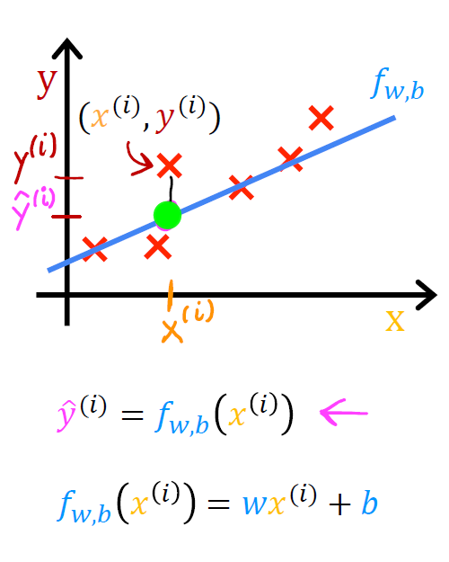
Tech Requirements
Linear Regression
Machine Learning Course
Abdel Rahman AlSabbagh
Notes:
One solution is to hold out part of the training pictures (from the web) in yet another set that
Andrew Ng calls the train-dev set. After the model is trained (on the training set, not
on the train-dev set), you can evaluate it on the train-dev set: if it performs well, then
the model is not overfitting the training set, so if performs poorly on the validation
set, the problem must come from the data mismatch. You can try to tackle this problem
by preprocessing the web images to make them look more like the pictures that
will be taken by the mobile app, and then retraining the model. Conversely, if the
model performs poorly on the train-dev set, then the model must have overfit the
training set, so you should try to simplify or regularize the model, get more training
data and clean up the training data, as discussed earlier.
No Free

Slide 13
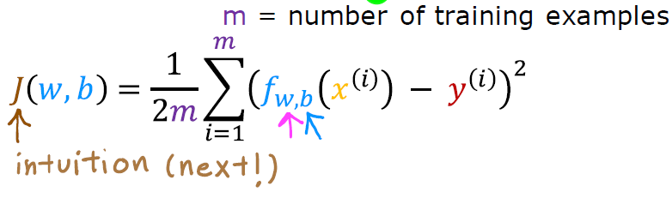
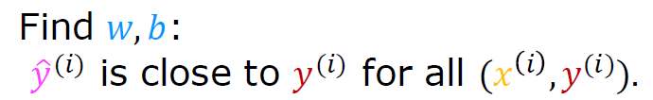
Tech Requirements
Loss and Cost Functions
Loss function
Cost function
Machine Learning Course
Abdel Rahman AlSabbagh
Notes:
One solution is to hold out part of the training pictures (from the web) in yet another set that
Andrew Ng calls the train-dev set. After the model is trained (on the training set, not
on the train-dev set), you can evaluate it on the train-dev set: if it performs well, then
the model is not overfitting the training set, so if performs poorly on the validation
set, the problem must come from the data mismatch. You can try to tackle this problem
by preprocessing the web images to make them look more like the pictures that
will be taken by the mobile app, and then retraining the model. Conversely, if the
model performs poorly on the train-dev set, then the model must have overfit the
training set, so you should try to simplify or regularize the model, get more training
data and clean up the training data, as discussed earlier.
No Free

Slide 14
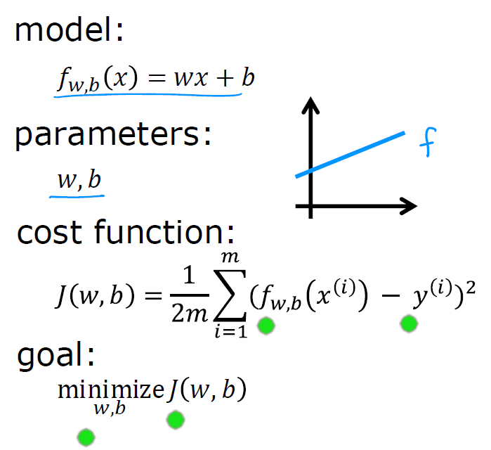
Tech Requirements
Cost Function
Machine Learning Course
Abdel Rahman AlSabbagh
Notes:
One solution is to hold out part of the training pictures (from the web) in yet another set that
Andrew Ng calls the train-dev set. After the model is trained (on the training set, not
on the train-dev set), you can evaluate it on the train-dev set: if it performs well, then
the model is not overfitting the training set, so if performs poorly on the validation
set, the problem must come from the data mismatch. You can try to tackle this problem
by preprocessing the web images to make them look more like the pictures that
will be taken by the mobile app, and then retraining the model. Conversely, if the
model performs poorly on the train-dev set, then the model must have overfit the
training set, so you should try to simplify or regularize the model, get more training
data and clean up the training data, as discussed earlier.
No Free

Slide 15
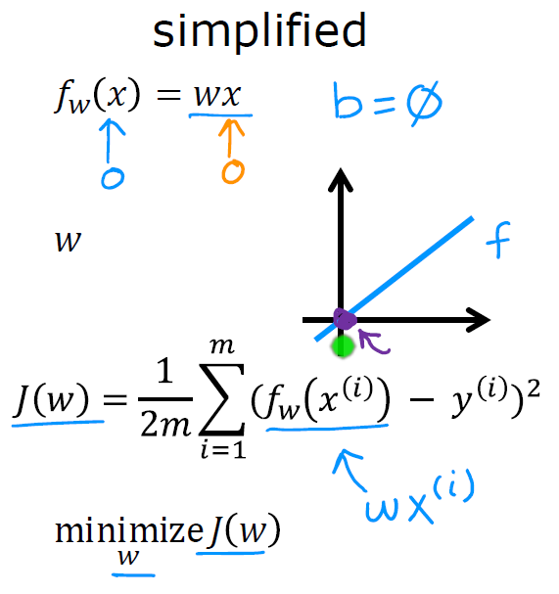
Tech Requirements
Cost Function
Machine Learning Course
Abdel Rahman AlSabbagh
Notes:
One solution is to hold out part of the training pictures (from the web) in yet another set that
Andrew Ng calls the train-dev set. After the model is trained (on the training set, not
on the train-dev set), you can evaluate it on the train-dev set: if it performs well, then
the model is not overfitting the training set, so if performs poorly on the validation
set, the problem must come from the data mismatch. You can try to tackle this problem
by preprocessing the web images to make them look more like the pictures that
will be taken by the mobile app, and then retraining the model. Conversely, if the
model performs poorly on the train-dev set, then the model must have overfit the
training set, so you should try to simplify or regularize the model, get more training
data and clean up the training data, as discussed earlier.
No Free

Slide 16
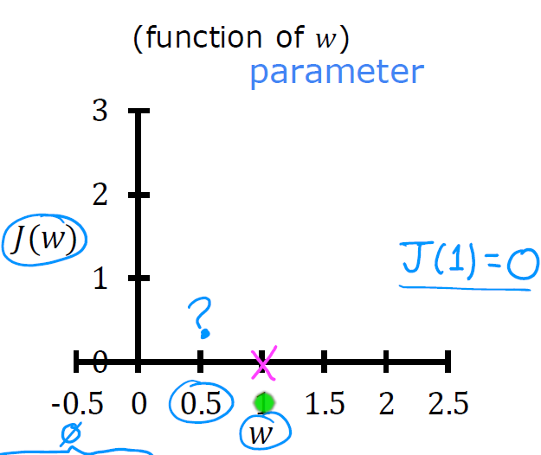
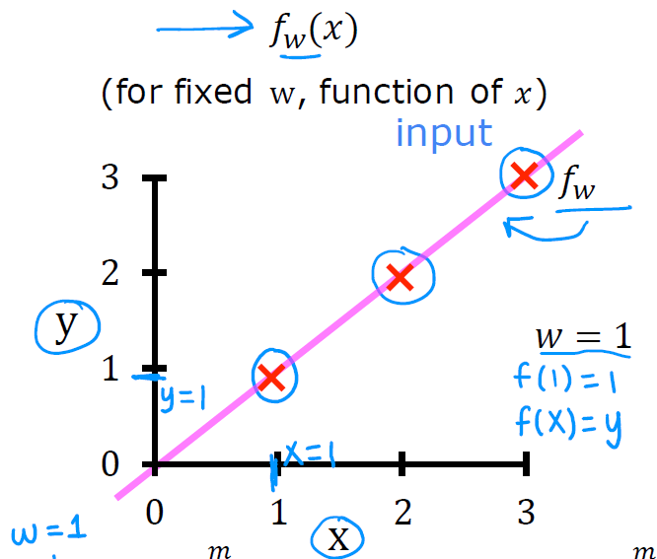
Tech Requirements
Cost Function
Machine Learning Course
Abdel Rahman AlSabbagh
Notes:
One solution is to hold out part of the training pictures (from the web) in yet another set that
Andrew Ng calls the train-dev set. After the model is trained (on the training set, not
on the train-dev set), you can evaluate it on the train-dev set: if it performs well, then
the model is not overfitting the training set, so if performs poorly on the validation
set, the problem must come from the data mismatch. You can try to tackle this problem
by preprocessing the web images to make them look more like the pictures that
will be taken by the mobile app, and then retraining the model. Conversely, if the
model performs poorly on the train-dev set, then the model must have overfit the
training set, so you should try to simplify or regularize the model, get more training
data and clean up the training data, as discussed earlier.
No Free

Slide 17
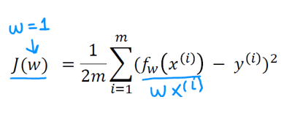
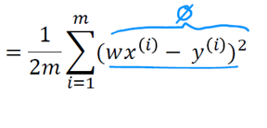
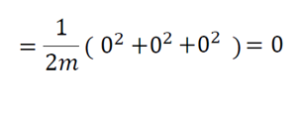
Tech Requirements
Cost Function
Machine Learning Course
Abdel Rahman AlSabbagh
Notes:
One solution is to hold out part of the training pictures (from the web) in yet another set that
Andrew Ng calls the train-dev set. After the model is trained (on the training set, not
on the train-dev set), you can evaluate it on the train-dev set: if it performs well, then
the model is not overfitting the training set, so if performs poorly on the validation
set, the problem must come from the data mismatch. You can try to tackle this problem
by preprocessing the web images to make them look more like the pictures that
will be taken by the mobile app, and then retraining the model. Conversely, if the
model performs poorly on the train-dev set, then the model must have overfit the
training set, so you should try to simplify or regularize the model, get more training
data and clean up the training data, as discussed earlier.
No Free

Slide 18
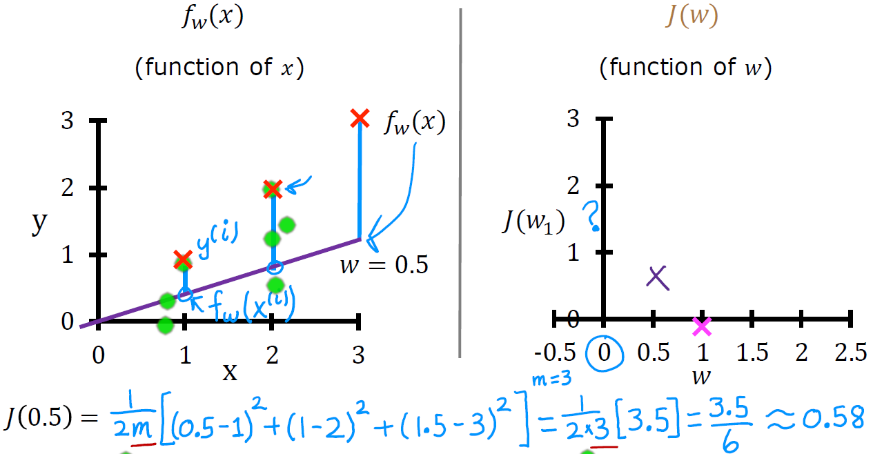
Cost Function
Machine Learning Course
Abdel Rahman AlSabbagh
Notes:
One solution is to hold out part of the training pictures (from the web) in yet another set that
Andrew Ng calls the train-dev set. After the model is trained (on the training set, not
on the train-dev set), you can evaluate it on the train-dev set: if it performs well, then
the model is not overfitting the training set, so if performs poorly on the validation
set, the problem must come from the data mismatch. You can try to tackle this problem
by preprocessing the web images to make them look more like the pictures that
will be taken by the mobile app, and then retraining the model. Conversely, if the
model performs poorly on the train-dev set, then the model must have overfit the
training set, so you should try to simplify or regularize the model, get more training
data and clean up the training data, as discussed earlier.
No Free

Slide 19
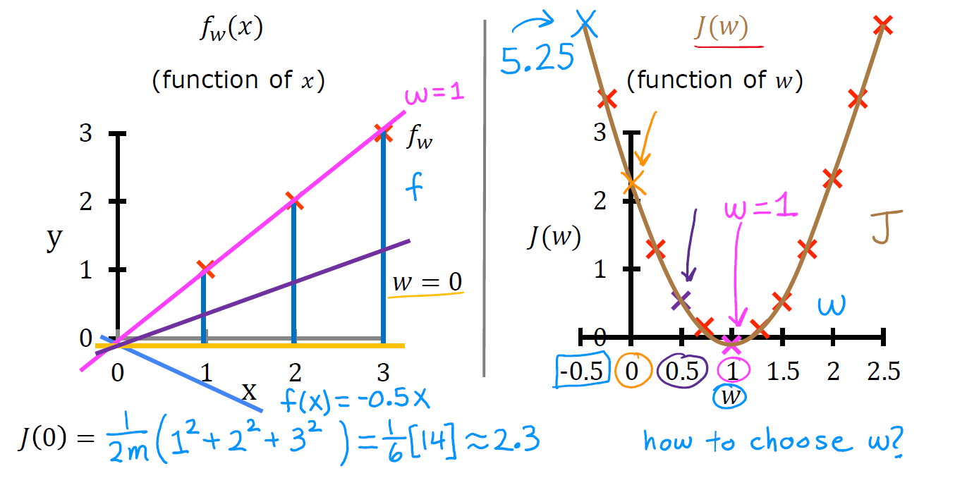
Cost Function
Machine Learning Course
Abdel Rahman AlSabbagh
Notes:
One solution is to hold out part of the training pictures (from the web) in yet another set that
Andrew Ng calls the train-dev set. After the model is trained (on the training set, not
on the train-dev set), you can evaluate it on the train-dev set: if it performs well, then
the model is not overfitting the training set, so if performs poorly on the validation
set, the problem must come from the data mismatch. You can try to tackle this problem
by preprocessing the web images to make them look more like the pictures that
will be taken by the mobile app, and then retraining the model. Conversely, if the
model performs poorly on the train-dev set, then the model must have overfit the
training set, so you should try to simplify or regularize the model, get more training
data and clean up the training data, as discussed earlier.
No Free

Slide 20
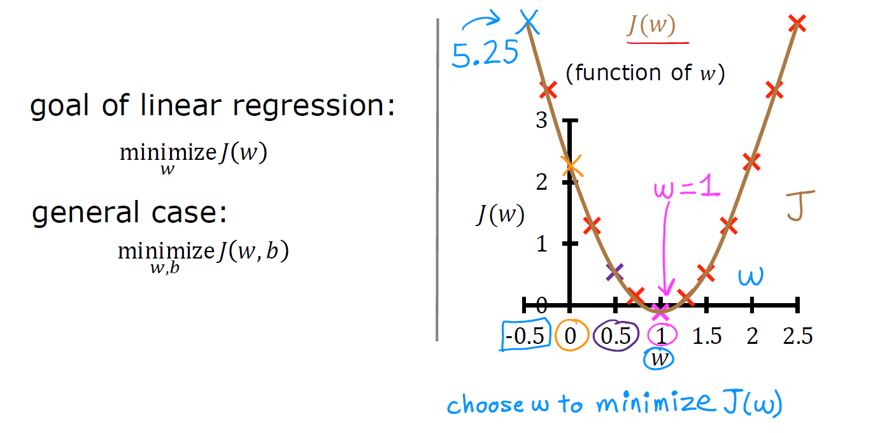
Cost Function
Machine Learning Course
Abdel Rahman AlSabbagh
Notes:
One solution is to hold out part of the training pictures (from the web) in yet another set that
Andrew Ng calls the train-dev set. After the model is trained (on the training set, not
on the train-dev set), you can evaluate it on the train-dev set: if it performs well, then
the model is not overfitting the training set, so if performs poorly on the validation
set, the problem must come from the data mismatch. You can try to tackle this problem
by preprocessing the web images to make them look more like the pictures that
will be taken by the mobile app, and then retraining the model. Conversely, if the
model performs poorly on the train-dev set, then the model must have overfit the
training set, so you should try to simplify or regularize the model, get more training
data and clean up the training data, as discussed earlier.
No Free

Slide 21
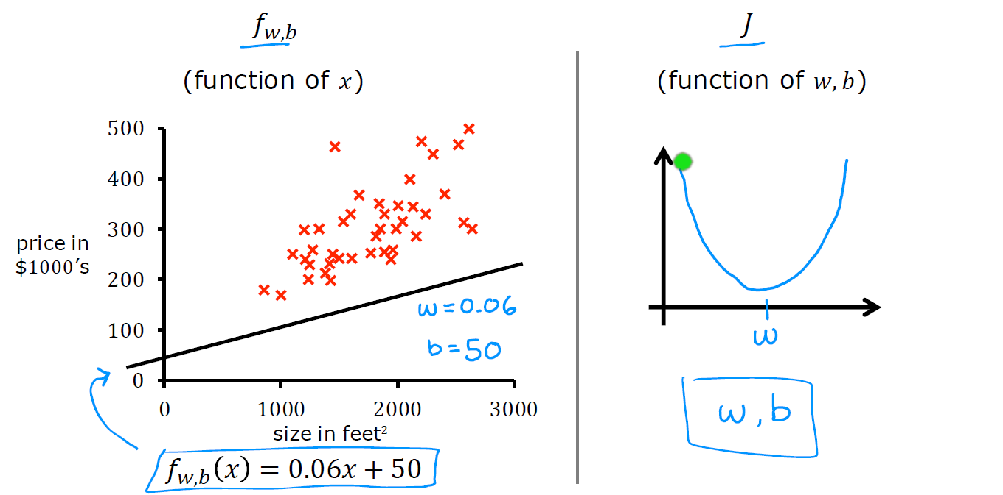
Visualizing the Cost Function
Machine Learning Course
Abdel Rahman AlSabbagh
Notes:
One solution is to hold out part of the training pictures (from the web) in yet another set that
Andrew Ng calls the train-dev set. After the model is trained (on the training set, not
on the train-dev set), you can evaluate it on the train-dev set: if it performs well, then
the model is not overfitting the training set, so if performs poorly on the validation
set, the problem must come from the data mismatch. You can try to tackle this problem
by preprocessing the web images to make them look more like the pictures that
will be taken by the mobile app, and then retraining the model. Conversely, if the
model performs poorly on the train-dev set, then the model must have overfit the
training set, so you should try to simplify or regularize the model, get more training
data and clean up the training data, as discussed earlier.
No Free

Slide 22
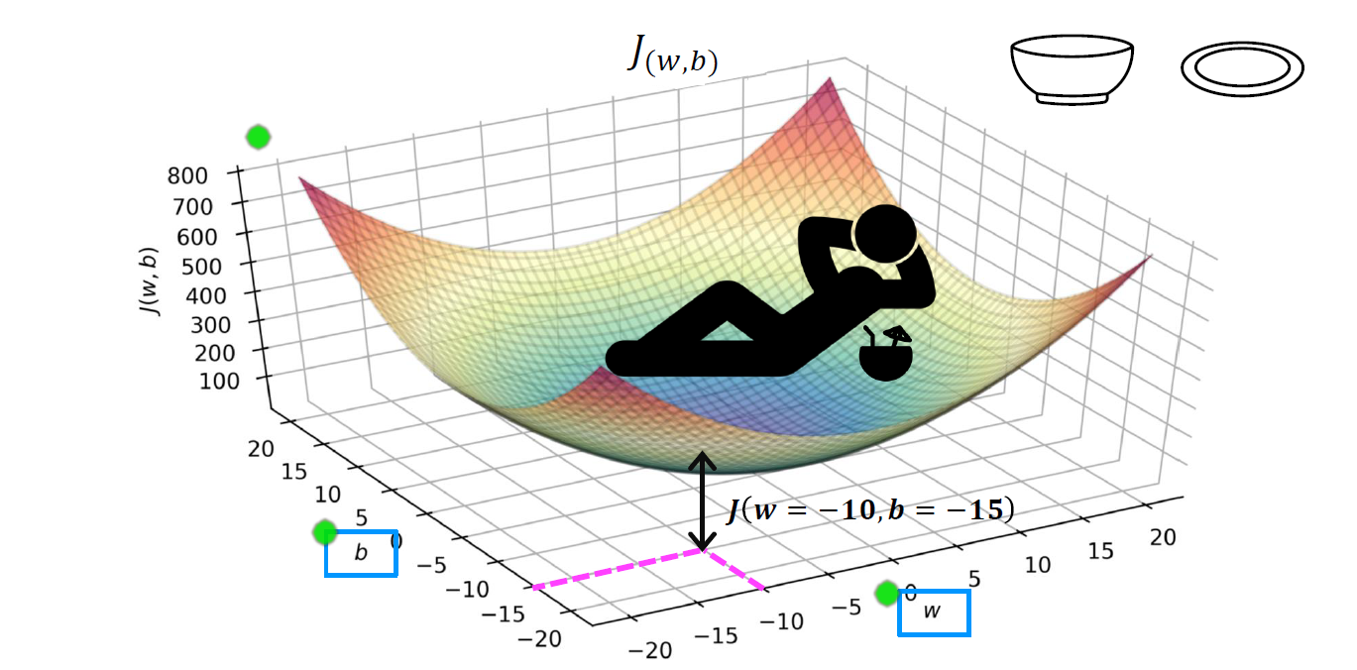
Visualizing the Cost Function
Machine Learning Course
Abdel Rahman AlSabbagh
Notes:
One solution is to hold out part of the training pictures (from the web) in yet another set that
Andrew Ng calls the train-dev set. After the model is trained (on the training set, not
on the train-dev set), you can evaluate it on the train-dev set: if it performs well, then
the model is not overfitting the training set, so if performs poorly on the validation
set, the problem must come from the data mismatch. You can try to tackle this problem
by preprocessing the web images to make them look more like the pictures that
will be taken by the mobile app, and then retraining the model. Conversely, if the
model performs poorly on the train-dev set, then the model must have overfit the
training set, so you should try to simplify or regularize the model, get more training
data and clean up the training data, as discussed earlier.
No Free

Slide 23
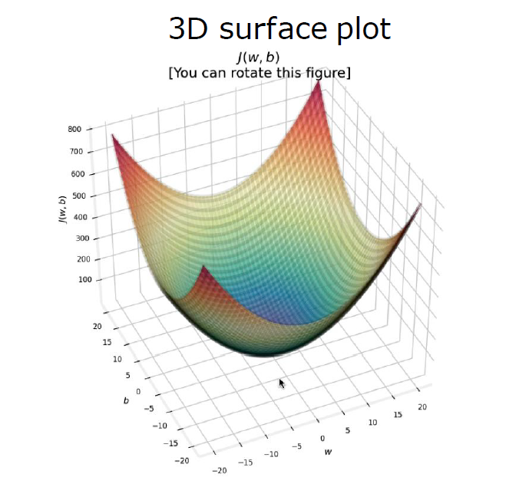
Visualizing the Cost Function
Machine Learning Course
Abdel Rahman AlSabbagh
Notes:
One solution is to hold out part of the training pictures (from the web) in yet another set that
Andrew Ng calls the train-dev set. After the model is trained (on the training set, not
on the train-dev set), you can evaluate it on the train-dev set: if it performs well, then
the model is not overfitting the training set, so if performs poorly on the validation
set, the problem must come from the data mismatch. You can try to tackle this problem
by preprocessing the web images to make them look more like the pictures that
will be taken by the mobile app, and then retraining the model. Conversely, if the
model performs poorly on the train-dev set, then the model must have overfit the
training set, so you should try to simplify or regularize the model, get more training
data and clean up the training data, as discussed earlier.
No Free

Slide 24
Visualizing the Cost Function
Machine Learning Course
Abdel Rahman AlSabbagh
Notes:
One solution is to hold out part of the training pictures (from the web) in yet another set that
Andrew Ng calls the train-dev set. After the model is trained (on the training set, not
on the train-dev set), you can evaluate it on the train-dev set: if it performs well, then
the model is not overfitting the training set, so if performs poorly on the validation
set, the problem must come from the data mismatch. You can try to tackle this problem
by preprocessing the web images to make them look more like the pictures that
will be taken by the mobile app, and then retraining the model. Conversely, if the
model performs poorly on the train-dev set, then the model must have overfit the
training set, so you should try to simplify or regularize the model, get more training
data and clean up the training data, as discussed earlier.
No Free

Slide 25
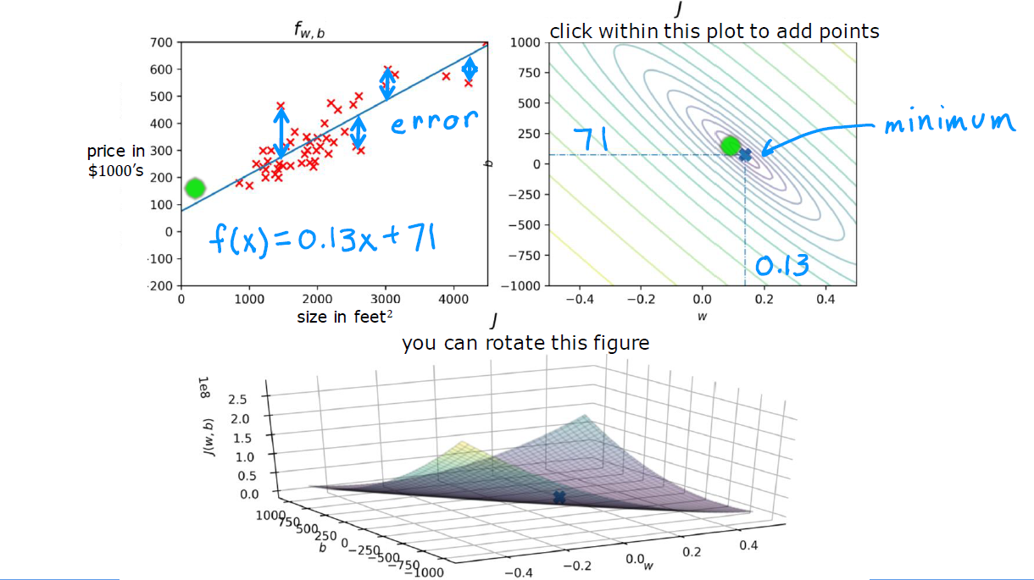
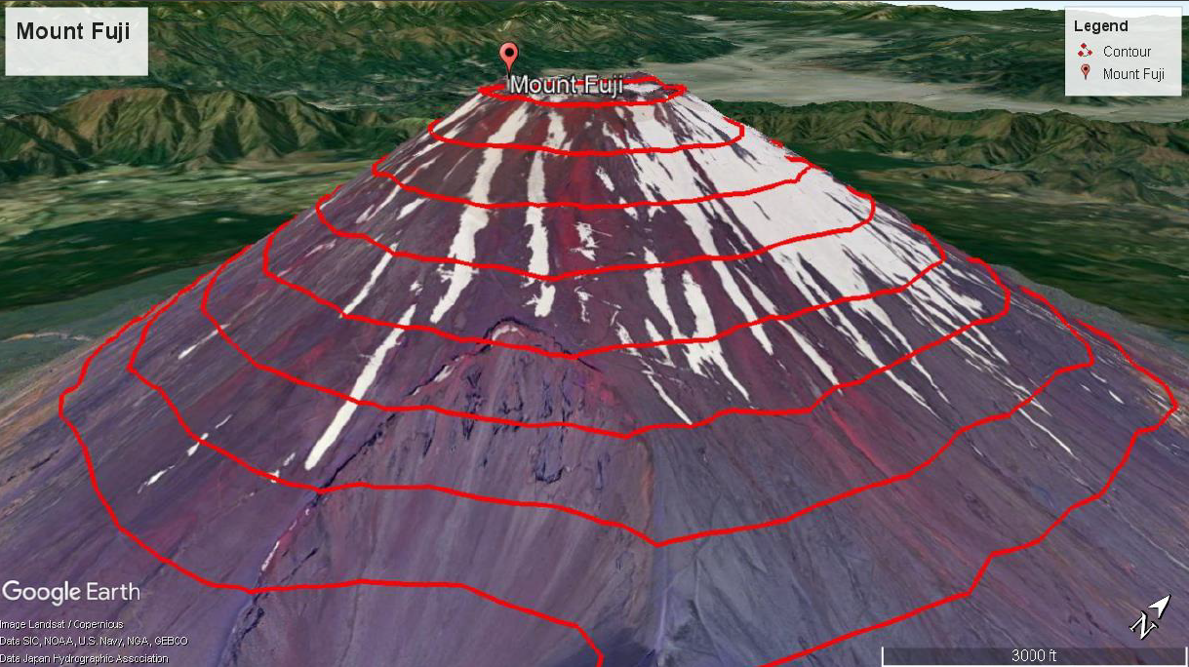
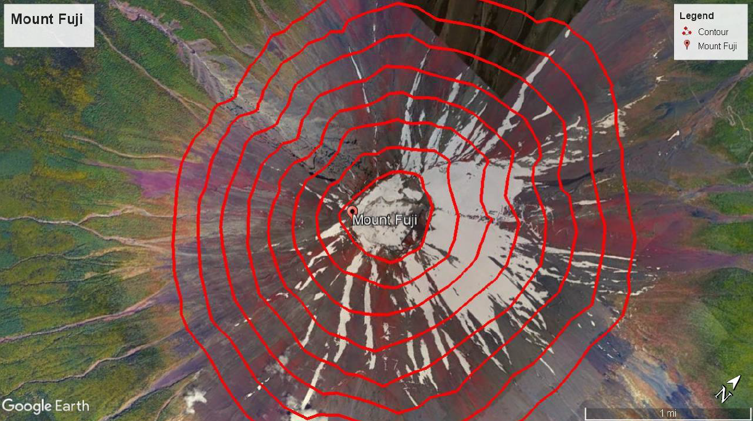
Visualizing the Cost Function
Machine Learning Course
Abdel Rahman AlSabbagh
Notes:
One solution is to hold out part of the training pictures (from the web) in yet another set that
Andrew Ng calls the train-dev set. After the model is trained (on the training set, not
on the train-dev set), you can evaluate it on the train-dev set: if it performs well, then
the model is not overfitting the training set, so if performs poorly on the validation
set, the problem must come from the data mismatch. You can try to tackle this problem
by preprocessing the web images to make them look more like the pictures that
will be taken by the mobile app, and then retraining the model. Conversely, if the
model performs poorly on the train-dev set, then the model must have overfit the
training set, so you should try to simplify or regularize the model, get more training
data and clean up the training data, as discussed earlier.
No Free

Slide 26
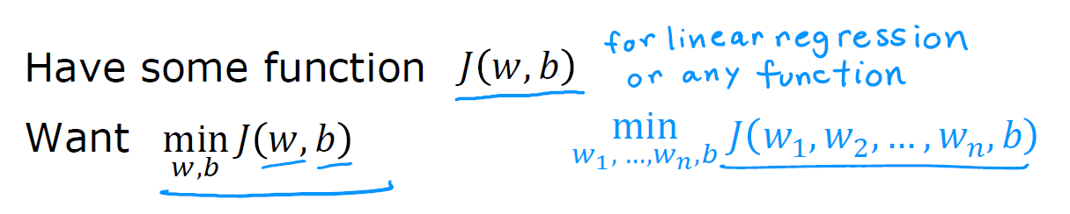

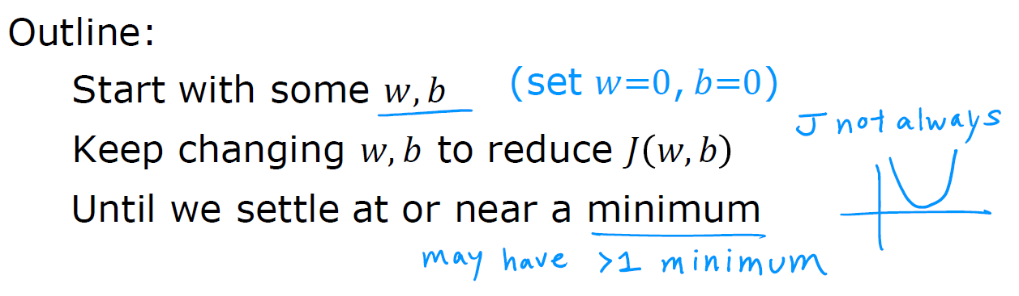
Gradient Descent
Machine Learning Course
Abdel Rahman AlSabbagh
Notes:
One solution is to hold out part of the training pictures (from the web) in yet another set that
Andrew Ng calls the train-dev set. After the model is trained (on the training set, not
on the train-dev set), you can evaluate it on the train-dev set: if it performs well, then
the model is not overfitting the training set, so if performs poorly on the validation
set, the problem must come from the data mismatch. You can try to tackle this problem
by preprocessing the web images to make them look more like the pictures that
will be taken by the mobile app, and then retraining the model. Conversely, if the
model performs poorly on the train-dev set, then the model must have overfit the
training set, so you should try to simplify or regularize the model, get more training
data and clean up the training data, as discussed earlier.
No Free

Slide 27
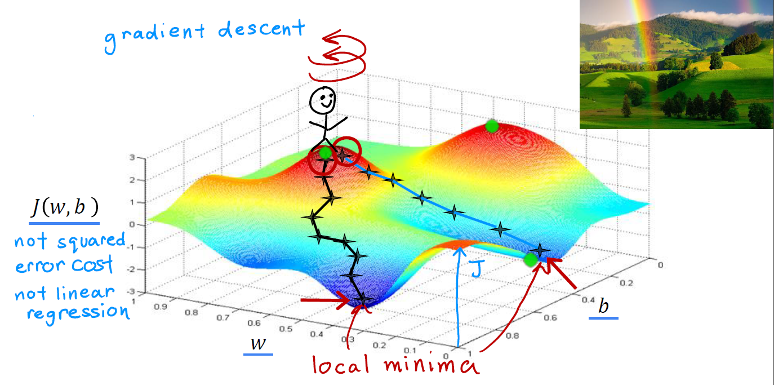
Gradient Descent
Machine Learning Course
Abdel Rahman AlSabbagh
Notes:
One solution is to hold out part of the training pictures (from the web) in yet another set that
Andrew Ng calls the train-dev set. After the model is trained (on the training set, not
on the train-dev set), you can evaluate it on the train-dev set: if it performs well, then
the model is not overfitting the training set, so if performs poorly on the validation
set, the problem must come from the data mismatch. You can try to tackle this problem
by preprocessing the web images to make them look more like the pictures that
will be taken by the mobile app, and then retraining the model. Conversely, if the
model performs poorly on the train-dev set, then the model must have overfit the
training set, so you should try to simplify or regularize the model, get more training
data and clean up the training data, as discussed earlier.
No Free

Slide 28
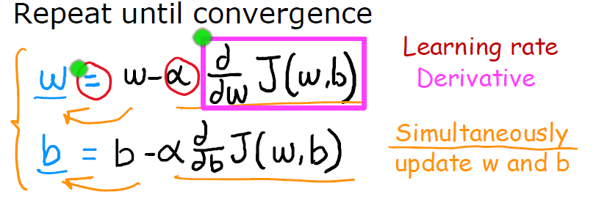
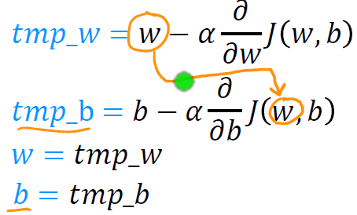
Gradient Descent Algorithm
Machine Learning Course
Abdel Rahman AlSabbagh
Notes:
One solution is to hold out part of the training pictures (from the web) in yet another set that
Andrew Ng calls the train-dev set. After the model is trained (on the training set, not
on the train-dev set), you can evaluate it on the train-dev set: if it performs well, then
the model is not overfitting the training set, so if performs poorly on the validation
set, the problem must come from the data mismatch. You can try to tackle this problem
by preprocessing the web images to make them look more like the pictures that
will be taken by the mobile app, and then retraining the model. Conversely, if the
model performs poorly on the train-dev set, then the model must have overfit the
training set, so you should try to simplify or regularize the model, get more training
data and clean up the training data, as discussed earlier.
No Free

Slide 29
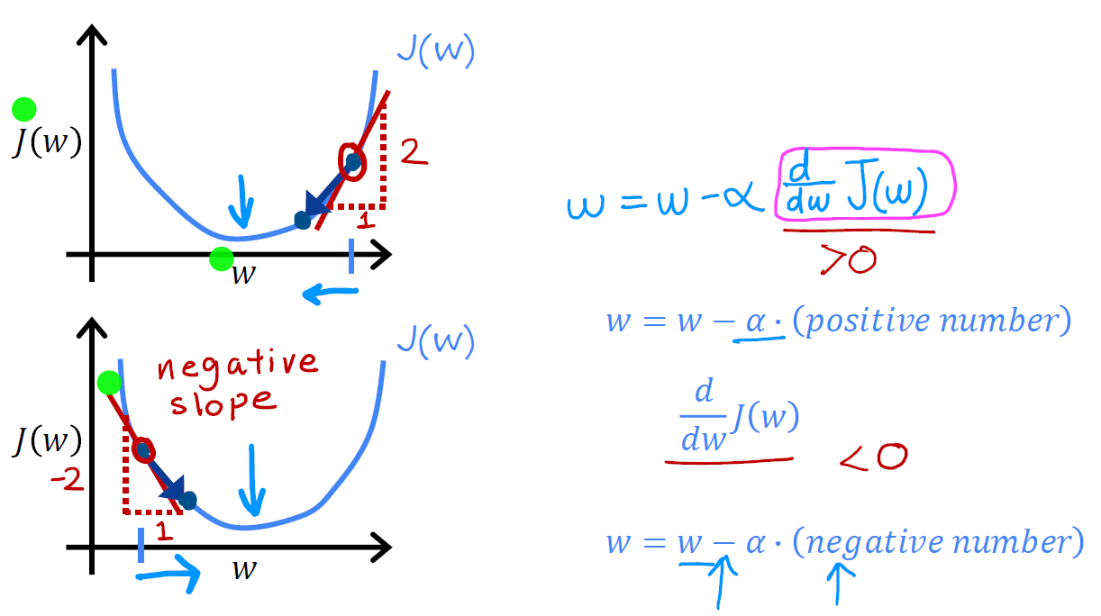
Gradient Descent Algorithm
Machine Learning Course
Abdel Rahman AlSabbagh
Notes:
One solution is to hold out part of the training pictures (from the web) in yet another set that
Andrew Ng calls the train-dev set. After the model is trained (on the training set, not
on the train-dev set), you can evaluate it on the train-dev set: if it performs well, then
the model is not overfitting the training set, so if performs poorly on the validation
set, the problem must come from the data mismatch. You can try to tackle this problem
by preprocessing the web images to make them look more like the pictures that
will be taken by the mobile app, and then retraining the model. Conversely, if the
model performs poorly on the train-dev set, then the model must have overfit the
training set, so you should try to simplify or regularize the model, get more training
data and clean up the training data, as discussed earlier.
No Free

Slide 30
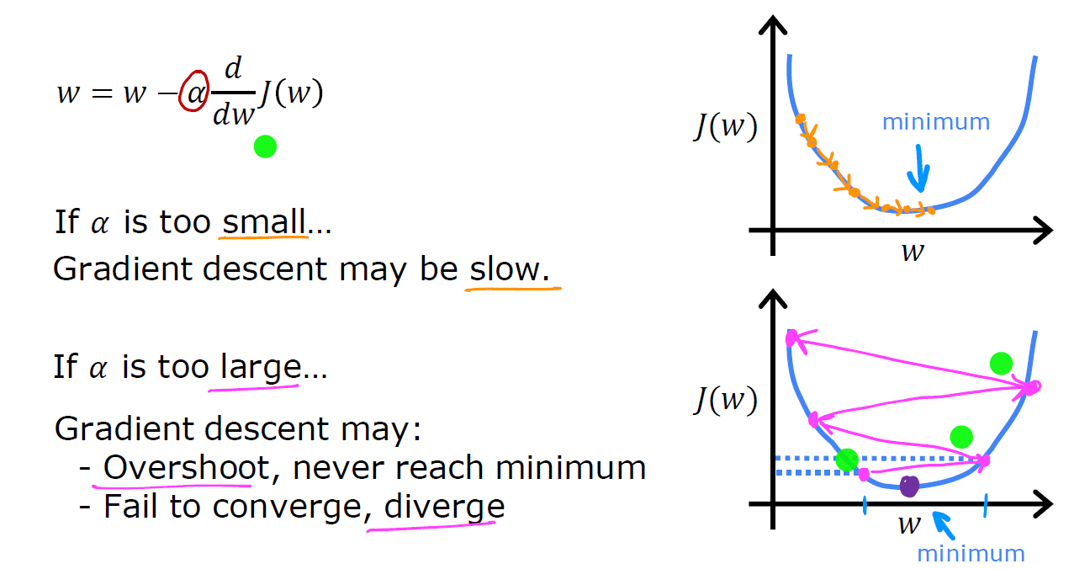
Gradient Descent Algorithm
Machine Learning Course
Abdel Rahman AlSabbagh
Notes:
One solution is to hold out part of the training pictures (from the web) in yet another set that
Andrew Ng calls the train-dev set. After the model is trained (on the training set, not
on the train-dev set), you can evaluate it on the train-dev set: if it performs well, then
the model is not overfitting the training set, so if performs poorly on the validation
set, the problem must come from the data mismatch. You can try to tackle this problem
by preprocessing the web images to make them look more like the pictures that
will be taken by the mobile app, and then retraining the model. Conversely, if the
model performs poorly on the train-dev set, then the model must have overfit the
training set, so you should try to simplify or regularize the model, get more training
data and clean up the training data, as discussed earlier.
No Free

Slide 31
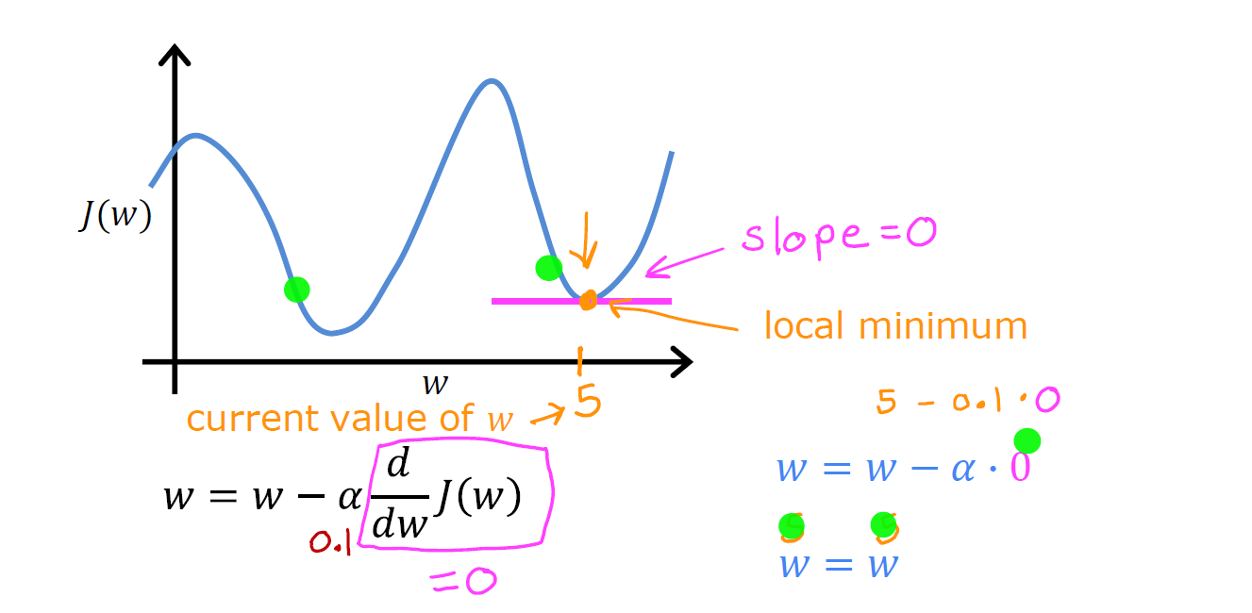
Gradient Descent Algorithm
Machine Learning Course
Abdel Rahman AlSabbagh
Notes:
One solution is to hold out part of the training pictures (from the web) in yet another set that
Andrew Ng calls the train-dev set. After the model is trained (on the training set, not
on the train-dev set), you can evaluate it on the train-dev set: if it performs well, then
the model is not overfitting the training set, so if performs poorly on the validation
set, the problem must come from the data mismatch. You can try to tackle this problem
by preprocessing the web images to make them look more like the pictures that
will be taken by the mobile app, and then retraining the model. Conversely, if the
model performs poorly on the train-dev set, then the model must have overfit the
training set, so you should try to simplify or regularize the model, get more training
data and clean up the training data, as discussed earlier.
No Free

Slide 32
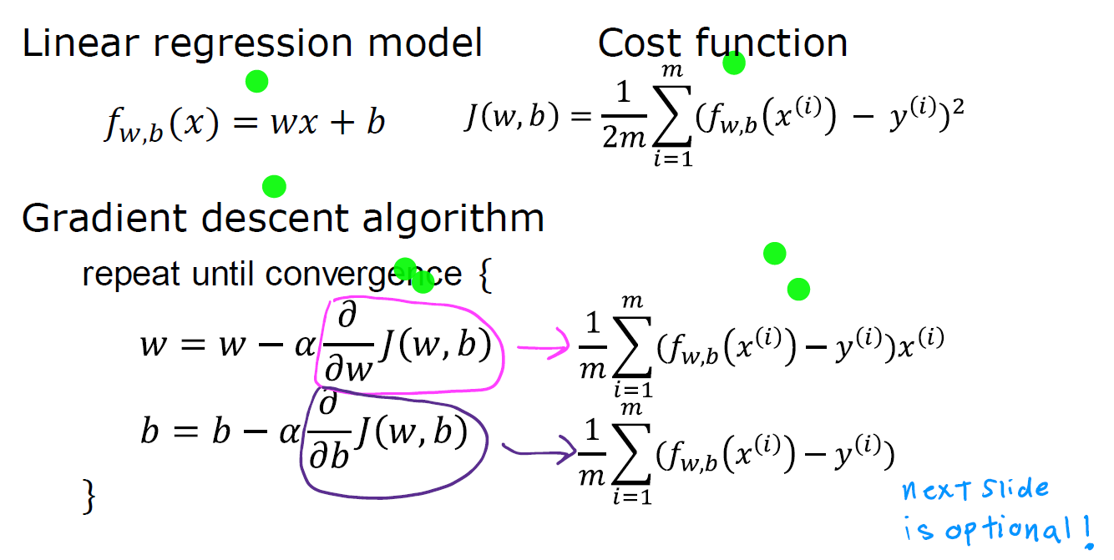

Gradient Descent for Linear Regression
Machine Learning Course
Abdel Rahman AlSabbagh
Notes:
One solution is to hold out part of the training pictures (from the web) in yet another set that
Andrew Ng calls the train-dev set. After the model is trained (on the training set, not
on the train-dev set), you can evaluate it on the train-dev set: if it performs well, then
the model is not overfitting the training set, so if performs poorly on the validation
set, the problem must come from the data mismatch. You can try to tackle this problem
by preprocessing the web images to make them look more like the pictures that
will be taken by the mobile app, and then retraining the model. Conversely, if the
model performs poorly on the train-dev set, then the model must have overfit the
training set, so you should try to simplify or regularize the model, get more training
data and clean up the training data, as discussed earlier.
No Free

Slide 33
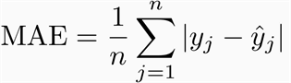
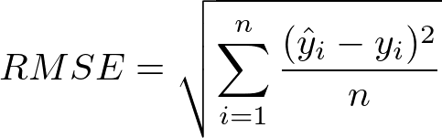
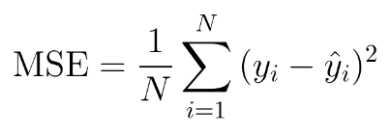
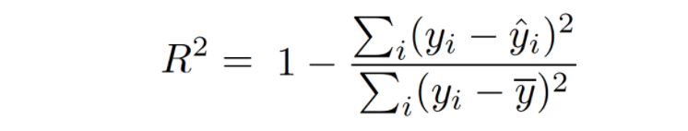
Evaluation Metrics for Linear Regression
Mean Absolute Error
Root Mean Squared Error
Mean Squared Error
R Squared
Machine Learning Course
Abdel Rahman AlSabbagh
Notes:
One solution is to hold out part of the training pictures (from the web) in yet another set that
Andrew Ng calls the train-dev set. After the model is trained (on the training set, not
on the train-dev set), you can evaluate it on the train-dev set: if it performs well, then
the model is not overfitting the training set, so if performs poorly on the validation
set, the problem must come from the data mismatch. You can try to tackle this problem
by preprocessing the web images to make them look more like the pictures that
will be taken by the mobile app, and then retraining the model. Conversely, if the
model performs poorly on the train-dev set, then the model must have overfit the
training set, so you should try to simplify or regularize the model, get more training
data and clean up the training data, as discussed earlier.
No Free

Slide 34
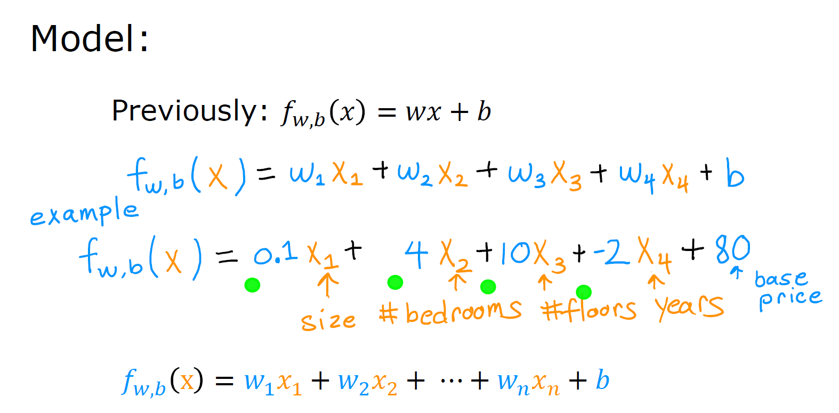

Linear Regression for Multiple Features
Machine Learning Course
Abdel Rahman AlSabbagh
Notes:
One solution is to hold out part of the training pictures (from the web) in yet another set that
Andrew Ng calls the train-dev set. After the model is trained (on the training set, not
on the train-dev set), you can evaluate it on the train-dev set: if it performs well, then
the model is not overfitting the training set, so if performs poorly on the validation
set, the problem must come from the data mismatch. You can try to tackle this problem
by preprocessing the web images to make them look more like the pictures that
will be taken by the mobile app, and then retraining the model. Conversely, if the
model performs poorly on the train-dev set, then the model must have overfit the
training set, so you should try to simplify or regularize the model, get more training
data and clean up the training data, as discussed earlier.
No Free

Slide 35
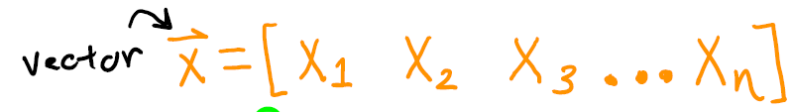
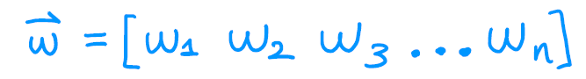

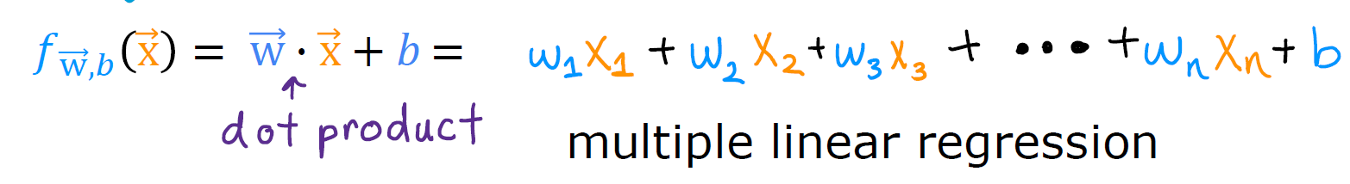
Linear Regression for Multiple Features
Machine Learning Course
Abdel Rahman AlSabbagh
Notes:
One solution is to hold out part of the training pictures (from the web) in yet another set that
Andrew Ng calls the train-dev set. After the model is trained (on the training set, not
on the train-dev set), you can evaluate it on the train-dev set: if it performs well, then
the model is not overfitting the training set, so if performs poorly on the validation
set, the problem must come from the data mismatch. You can try to tackle this problem
by preprocessing the web images to make them look more like the pictures that
will be taken by the mobile app, and then retraining the model. Conversely, if the
model performs poorly on the train-dev set, then the model must have overfit the
training set, so you should try to simplify or regularize the model, get more training
data and clean up the training data, as discussed earlier.
No Free

Slide 36
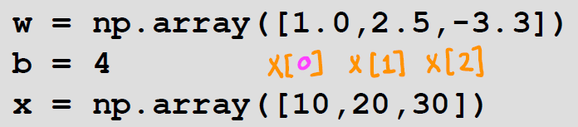
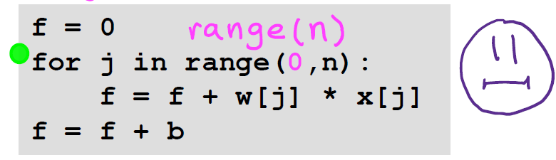
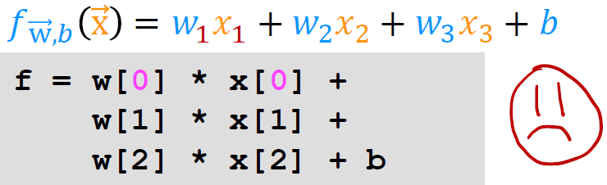
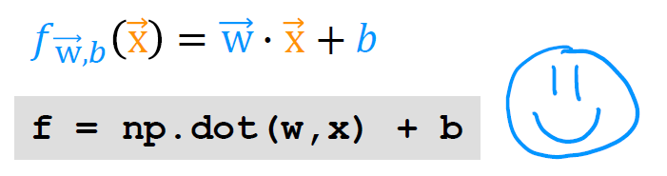
Vectorization
Machine Learning Course
Abdel Rahman AlSabbagh
Notes:
One solution is to hold out part of the training pictures (from the web) in yet another set that
Andrew Ng calls the train-dev set. After the model is trained (on the training set, not
on the train-dev set), you can evaluate it on the train-dev set: if it performs well, then
the model is not overfitting the training set, so if performs poorly on the validation
set, the problem must come from the data mismatch. You can try to tackle this problem
by preprocessing the web images to make them look more like the pictures that
will be taken by the mobile app, and then retraining the model. Conversely, if the
model performs poorly on the train-dev set, then the model must have overfit the
training set, so you should try to simplify or regularize the model, get more training
data and clean up the training data, as discussed earlier.
No Free

Slide 37
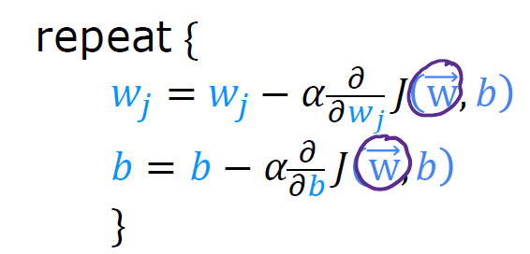
Gradient Descent for Multiple Features
Machine Learning Course
Abdel Rahman AlSabbagh
Notes:
One solution is to hold out part of the training pictures (from the web) in yet another set that
Andrew Ng calls the train-dev set. After the model is trained (on the training set, not
on the train-dev set), you can evaluate it on the train-dev set: if it performs well, then
the model is not overfitting the training set, so if performs poorly on the validation
set, the problem must come from the data mismatch. You can try to tackle this problem
by preprocessing the web images to make them look more like the pictures that
will be taken by the mobile app, and then retraining the model. Conversely, if the
model performs poorly on the train-dev set, then the model must have overfit the
training set, so you should try to simplify or regularize the model, get more training
data and clean up the training data, as discussed earlier.
No Free

Slide 38
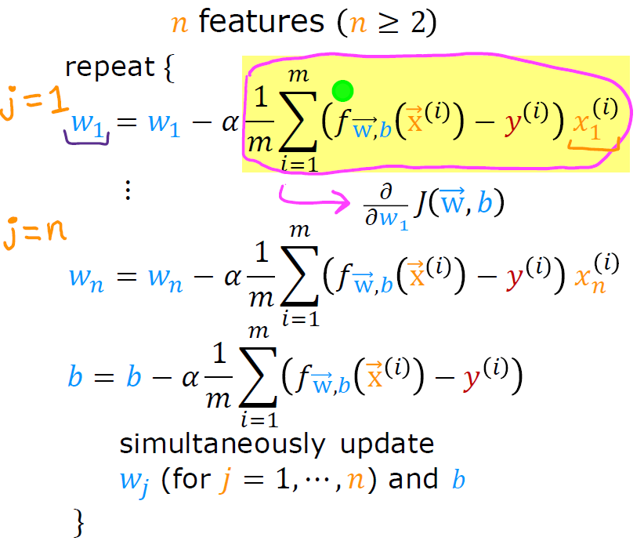
Gradient Descent for Multiple Features
Machine Learning Course
Abdel Rahman AlSabbagh
Notes:
One solution is to hold out part of the training pictures (from the web) in yet another set that
Andrew Ng calls the train-dev set. After the model is trained (on the training set, not
on the train-dev set), you can evaluate it on the train-dev set: if it performs well, then
the model is not overfitting the training set, so if performs poorly on the validation
set, the problem must come from the data mismatch. You can try to tackle this problem
by preprocessing the web images to make them look more like the pictures that
will be taken by the mobile app, and then retraining the model. Conversely, if the
model performs poorly on the train-dev set, then the model must have overfit the
training set, so you should try to simplify or regularize the model, get more training
data and clean up the training data, as discussed earlier.
No Free

Slide 39
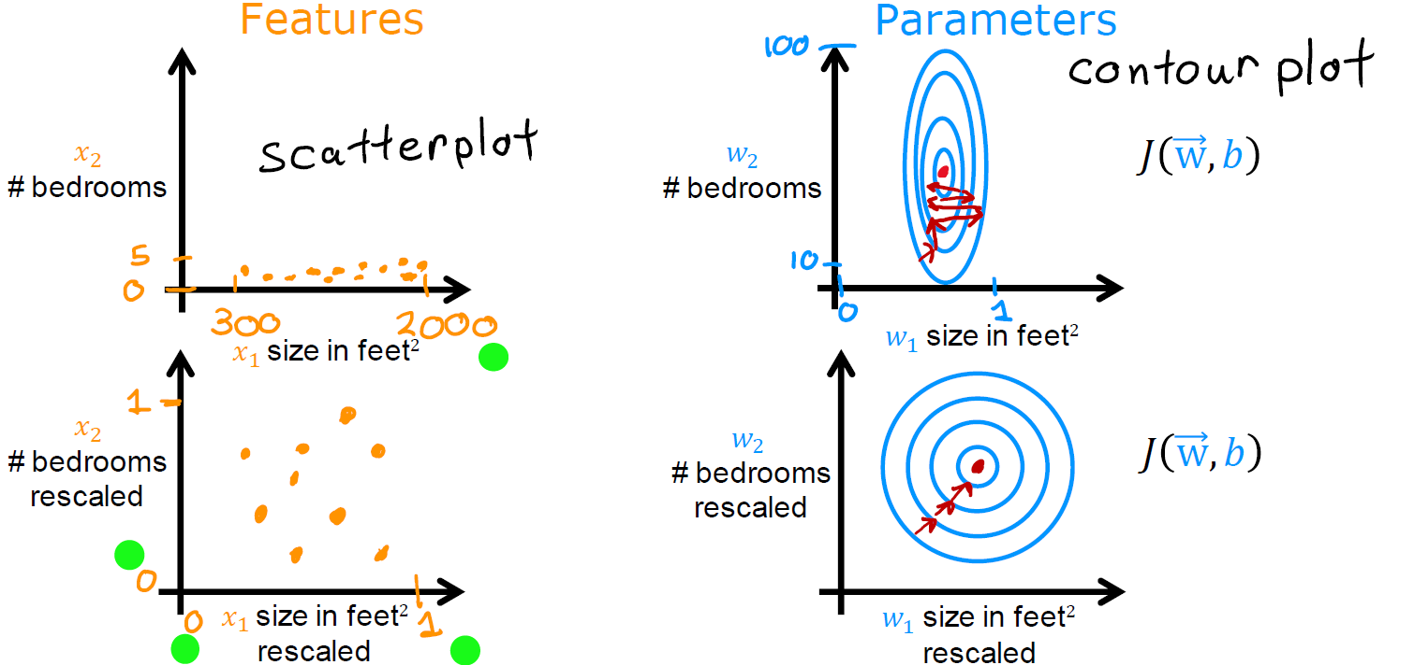
The Effect of Feature Scaling
Machine Learning Course
Abdel Rahman AlSabbagh
Notes:
One solution is to hold out part of the training pictures (from the web) in yet another set that
Andrew Ng calls the train-dev set. After the model is trained (on the training set, not
on the train-dev set), you can evaluate it on the train-dev set: if it performs well, then
the model is not overfitting the training set, so if performs poorly on the validation
set, the problem must come from the data mismatch. You can try to tackle this problem
by preprocessing the web images to make them look more like the pictures that
will be taken by the mobile app, and then retraining the model. Conversely, if the
model performs poorly on the train-dev set, then the model must have overfit the
training set, so you should try to simplify or regularize the model, get more training
data and clean up the training data, as discussed earlier.
No Free

Slide 40
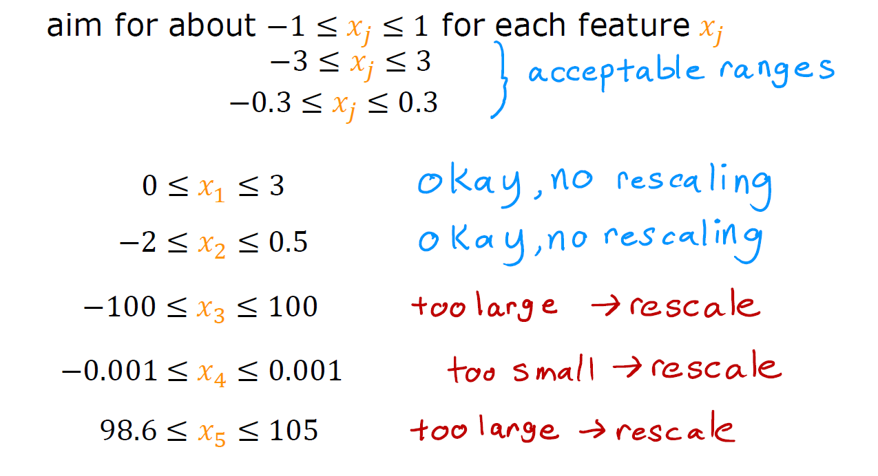
The Effect of Feature Scaling
Machine Learning Course
Abdel Rahman AlSabbagh
Notes:
One solution is to hold out part of the training pictures (from the web) in yet another set that
Andrew Ng calls the train-dev set. After the model is trained (on the training set, not
on the train-dev set), you can evaluate it on the train-dev set: if it performs well, then
the model is not overfitting the training set, so if performs poorly on the validation
set, the problem must come from the data mismatch. You can try to tackle this problem
by preprocessing the web images to make them look more like the pictures that
will be taken by the mobile app, and then retraining the model. Conversely, if the
model performs poorly on the train-dev set, then the model must have overfit the
training set, so you should try to simplify or regularize the model, get more training
data and clean up the training data, as discussed earlier.
No Free

Slide 41
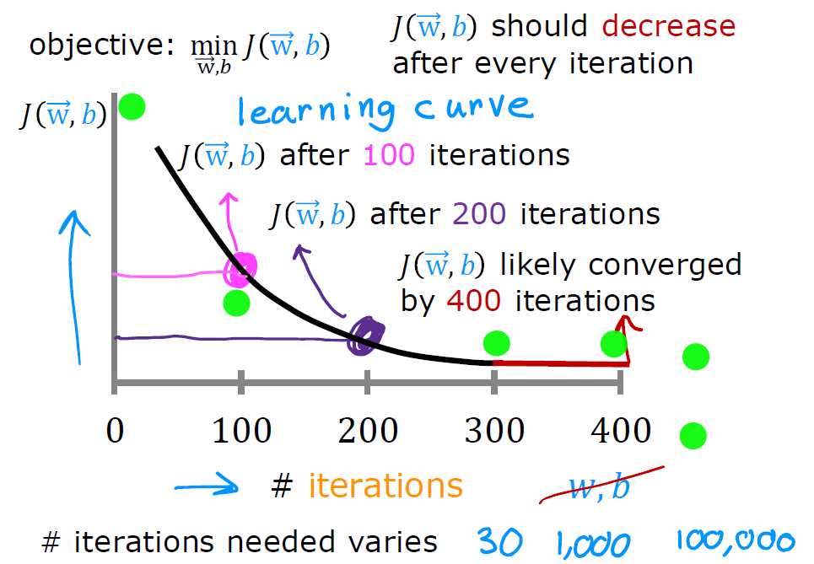

Making Sure Gradient Descent is Working
Machine Learning Course
Abdel Rahman AlSabbagh
Notes:
One solution is to hold out part of the training pictures (from the web) in yet another set that
Andrew Ng calls the train-dev set. After the model is trained (on the training set, not
on the train-dev set), you can evaluate it on the train-dev set: if it performs well, then
the model is not overfitting the training set, so if performs poorly on the validation
set, the problem must come from the data mismatch. You can try to tackle this problem
by preprocessing the web images to make them look more like the pictures that
will be taken by the mobile app, and then retraining the model. Conversely, if the
model performs poorly on the train-dev set, then the model must have overfit the
training set, so you should try to simplify or regularize the model, get more training
data and clean up the training data, as discussed earlier.
No Free

Slide 42
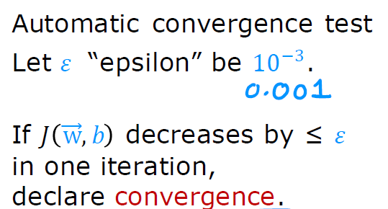
Checking Gradient Descent for Convergence
Machine Learning Course
Abdel Rahman AlSabbagh
Notes:
One solution is to hold out part of the training pictures (from the web) in yet another set that
Andrew Ng calls the train-dev set. After the model is trained (on the training set, not
on the train-dev set), you can evaluate it on the train-dev set: if it performs well, then
the model is not overfitting the training set, so if performs poorly on the validation
set, the problem must come from the data mismatch. You can try to tackle this problem
by preprocessing the web images to make them look more like the pictures that
will be taken by the mobile app, and then retraining the model. Conversely, if the
model performs poorly on the train-dev set, then the model must have overfit the
training set, so you should try to simplify or regularize the model, get more training
data and clean up the training data, as discussed earlier.
No Free

Slide 43
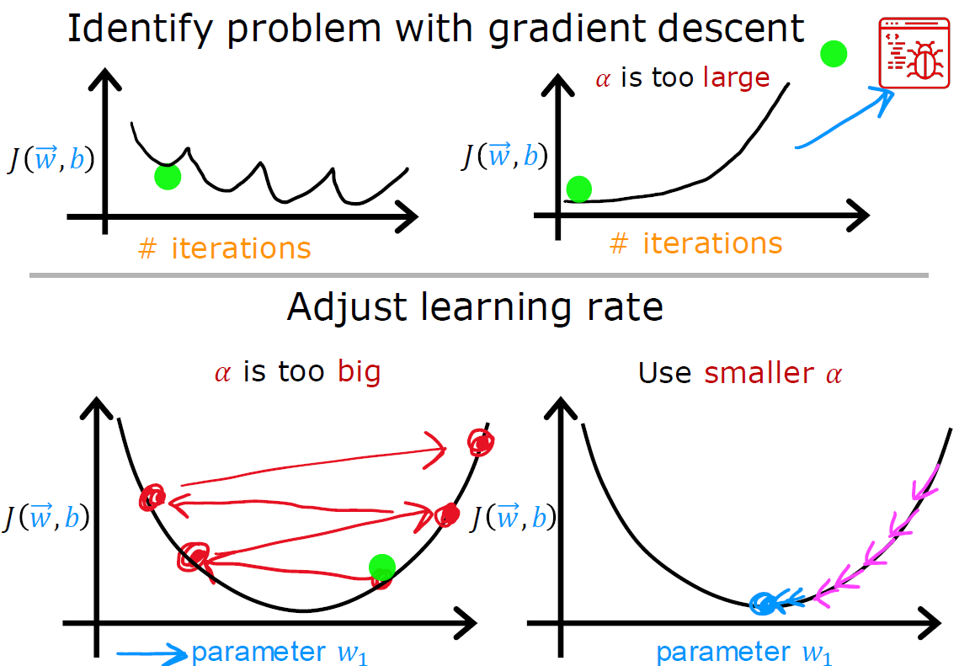
Choosing the Learning Rate
Machine Learning Course
Abdel Rahman AlSabbagh
Notes:
One solution is to hold out part of the training pictures (from the web) in yet another set that
Andrew Ng calls the train-dev set. After the model is trained (on the training set, not
on the train-dev set), you can evaluate it on the train-dev set: if it performs well, then
the model is not overfitting the training set, so if performs poorly on the validation
set, the problem must come from the data mismatch. You can try to tackle this problem
by preprocessing the web images to make them look more like the pictures that
will be taken by the mobile app, and then retraining the model. Conversely, if the
model performs poorly on the train-dev set, then the model must have overfit the
training set, so you should try to simplify or regularize the model, get more training
data and clean up the training data, as discussed earlier.
No Free

Slide 44


Choosing the Learning Rate
Machine Learning Course
Abdel Rahman AlSabbagh
Notes:
One solution is to hold out part of the training pictures (from the web) in yet another set that
Andrew Ng calls the train-dev set. After the model is trained (on the training set, not
on the train-dev set), you can evaluate it on the train-dev set: if it performs well, then
the model is not overfitting the training set, so if performs poorly on the validation
set, the problem must come from the data mismatch. You can try to tackle this problem
by preprocessing the web images to make them look more like the pictures that
will be taken by the mobile app, and then retraining the model. Conversely, if the
model performs poorly on the train-dev set, then the model must have overfit the
training set, so you should try to simplify or regularize the model, get more training
data and clean up the training data, as discussed earlier.
No Free

Slide 45

Polynomial Regression
Machine Learning Course
Abdel Rahman AlSabbagh
Notes:
One solution is to hold out part of the training pictures (from the web) in yet another set that
Andrew Ng calls the train-dev set. After the model is trained (on the training set, not
on the train-dev set), you can evaluate it on the train-dev set: if it performs well, then
the model is not overfitting the training set, so if performs poorly on the validation
set, the problem must come from the data mismatch. You can try to tackle this problem
by preprocessing the web images to make them look more like the pictures that
will be taken by the mobile app, and then retraining the model. Conversely, if the
model performs poorly on the train-dev set, then the model must have overfit the
training set, so you should try to simplify or regularize the model, get more training
data and clean up the training data, as discussed earlier.
No Free

Slide 46

Polynomial Regression
Machine Learning Course
Abdel Rahman AlSabbagh
Notes:
One solution is to hold out part of the training pictures (from the web) in yet another set that
Andrew Ng calls the train-dev set. After the model is trained (on the training set, not
on the train-dev set), you can evaluate it on the train-dev set: if it performs well, then
the model is not overfitting the training set, so if performs poorly on the validation
set, the problem must come from the data mismatch. You can try to tackle this problem
by preprocessing the web images to make them look more like the pictures that
will be taken by the mobile app, and then retraining the model. Conversely, if the
model performs poorly on the train-dev set, then the model must have overfit the
training set, so you should try to simplify or regularize the model, get more training
data and clean up the training data, as discussed earlier.
No Free

Slide 47


Thank You
Next lecture will be online on Mon, 15.5.2023, In Shaa allah!
sabbagh@ieee.org
Connect on Linkedin

